Slide 1
What Does It Mean to Be Presbyterian?
Week 2: Presbyterian Worship

Slide 2
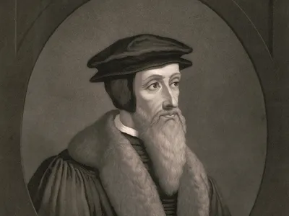
John Calvin on the True Church
The true church is found wherever:
The Word of God is rightly preached and heard
The Sacraments are rightly celebrated
Church discipline is rightly administered

Slide 3
A Contemporary Restatement
“We affirm that, in the power of the Spirit, the Church is faithful to the mission of Christ as it:
Proclaims and hears the Word of God,
responding to the promise of God’s new creation in Christ, and
inviting all people to participate in that new creation;
Administers and receives the Sacraments,
welcoming those who are being engrafted into Christ,
bearing witness to Christ’s saving death and resurrection,
anticipating the heavenly banquet that is to come, and
committing itself in the present to solidarity with the marginalized and the
hungry; and
Nurtures a covenant community of disciples of Christ,
living in the strength of God’s promise and
giving itself in service to God’s mission.”
F-1.0303

Slide 4
Word and Sacrament
“[T]he Church’s ministry emerges from the font, arises from the table, and takes its shape from the Word of the Lord. Therefore the worship of the triune God is the center of our common life and our primary way of witness to the faith, hope, and love we have in Jesus Christ.”
W-1.0107

Slide 5
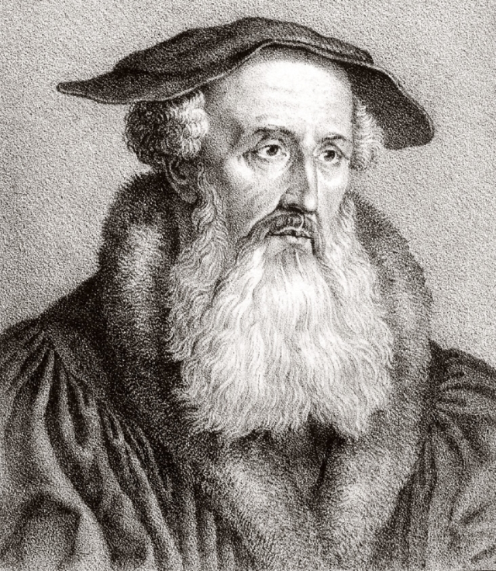
Word: Heinrich Bullinger on Proclamation
“The preaching of the Word of God is the Word of God.” (!)
“Where the Word is read and proclaimed, Jesus Christ the living Word is present by the power of the Holy Spirit.”
W-3.0301

Slide 6
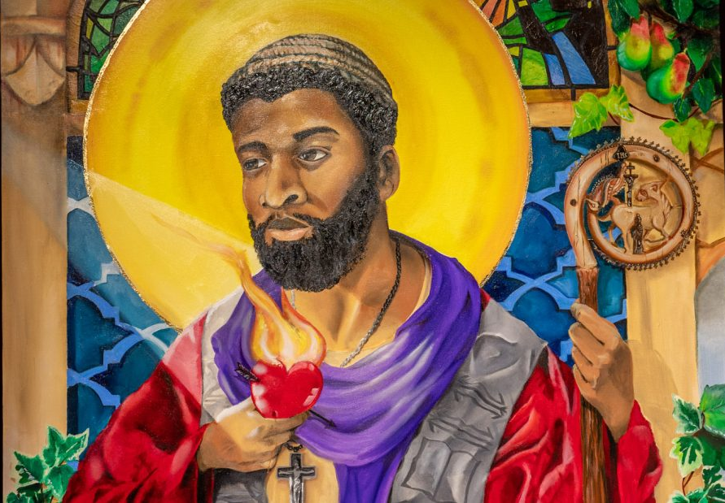
Sacraments
“A visible form of an invisible grace” (Augustine)
A seal
Something (1) instituted by Jesus, which includes (2) a sign and (3) a promise
Presbyterians recognize two sacraments: baptism and the Lord’s Supper

Slide 7
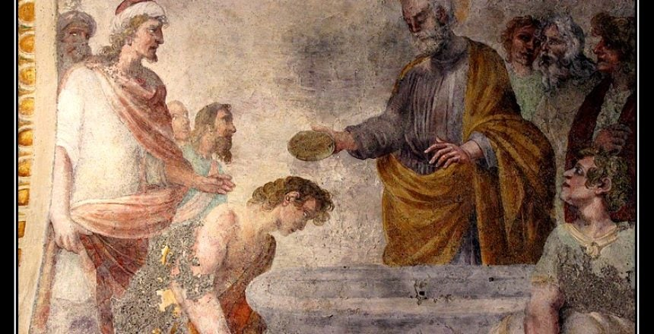
Sacraments: Baptism
Sign: water
Promise: “Surely, I am with you always, to the end of the age.”
“In life and in death, we belong to God.” (A Brief Statement of Faith)
Question: What does baptism represent to you?

Slide 8
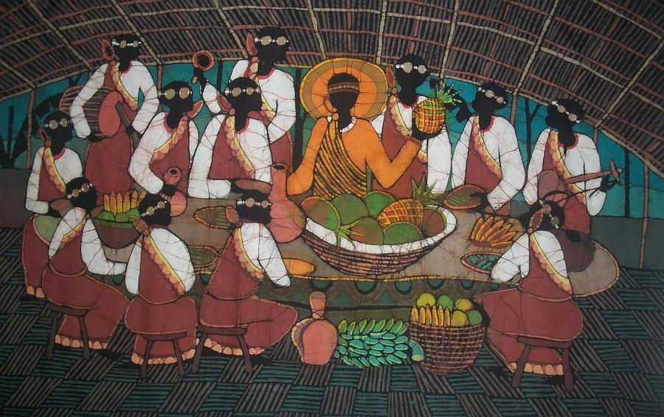
Sacraments: The Lord’s Supper
Sign: bread and wine/grape juice
Promise: “This is my body given for you” and “This is my blood shed for you”
It’s not just a memorial–Christ is “really present,” says Calvin!
We’re taken up to the risen Christ by the power of the Spirit
Question: What does the Lord’s Supper represent to you?

Slide 9
The Service for the Lord’s Day
Gathering
Call to Worship
Psalms, Hymns, and Spiritual Songs
Prayer
Confession
Declaration of Forgiveness
Word
Prayer for Illumination
Scripture
Sermon
Affirmation of Faith
Prayers of the People
Offering
Sacrament
Baptism
Lord’s Supper
Great Thanksgiving
Breaking of the Bread
Communion of the People
Sending
Acts of Commitment
Blessing and Charge
Service in the World

